Slide 1
OBE Implementation
Module-1:SCHOOLS
Submitted By
P. Srinidhi -> AP23110011027
I.Vinuthna -> AP23110011044
S.Vamsi -> AP23110011076
G.Venkat -> AP23110011064
D.Harsha -> AP23110011026
P.V.N.K.Sreehitha-> AP23110011037
Department : Btech ,Cse – O, 3rd semester

Slide 2
Introduction to Project
Our University (herewith considered as SRM-AP) is going to implement OBE(Outcome Based Education) in their university and you assigned in the project to develop an application with any programming Language you are well versed and you were supposed to do searching and sorting using learned algorithms,comparing your sorting algorithm with any one of existing algorithm,displaying the time complexity of both algorithms and explaining advantages and disadvantages of the algorithm

Slide 3
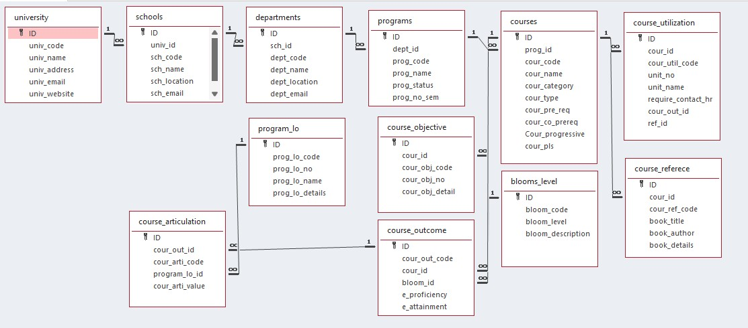
Architecture Diagram

Slide 4
Module Description : School Setting
This module is used to create,Update,Retrieve,Delete(hereafter known as CURD) details of the module and storing the details in the text file.you have to provide option for searching and sorting of fields mentioned below according to algorithms given for you

Slide 5
University Setting:Field/table details
Field Name | Data type
id | integer
sch_code | String
sch_name | String
sch_address | String
sch_email | String
sch_website | String

Slide 6
University Setting:Programming Details
File name: school_data.txt
Function/method name
Create: dream_coders_school_create()
Update: dream_coders_school_ update()
Retrieve: dream_coders_school_retrieve()
Delete: dream_coders_school_delete()
Sorting: dream_coders_school_bubble_sort()
Searching: dream_coders_school_binary_search()
Storing: dream_coders_school_load_from_file()

Slide 7
University Setting:Programming Details
Comparison(both searching and Sorting):
For Searching- void dream_coders_school_binary_search(int id)
For Sorting- void dream_coders_school_quick_sort(int low, int high)
Time Complexity(both searching and Sorting):
For Searching- dream_coders_school_display_time_complexities()
For Sorting- dream_coders_school_display_time_complexities()

Slide 8
University : Sorting Algorithm used and it’s Comparison
Sorting Algorithm Name: bubble sort.
Algorithm:
1.Start function dream_coders_school_bubble_sort().
2.Initialize two loop variables, i and j.
3.Declare a temporary variable temp of type sch to hold school data during swaps.
4.For each i from 0 to school_count - 2:
4.1 For each j from 0 to school_count - 2 - i:
4.1.1 If university[j].sch_Id is greater than university[j + 1].sch_Id:
4.1.1.1 Assign school[j] to temp.
4.1.1.2 Set school[j] to school[j + 1].
4.1.1.3 Set school[j + 1] to temp.
5.End function dream_coders_school_bubble_sort().
Sorting Algorithm Name: Quick sort.
Algorithm:
1.Start function dream_coders_school_quick_sort(low, high).
2.Check if low is less than high:
2.1 If true:
2.1.1 Set pivot to school[high].univ_Id.
2.1.2 Initialize i to low - 1.
2.1.3 For each j from low to high - 1:
2.1.3.1 If school[j].sch_Id is less than pivot:
2.1.3.1.1 Increment i by 1.
2.1.3.1.2 Set temp to school[i].
2.1.3.1.3 Assign school[j] to school[i].
2.1.3.1.4 Set temp to school[j].
2.1.4 Set temp to school[i + 1].
2.1.5 Assign school[high] to school[i + 1].
2.1.6 Set temp to school[high].
2.1.7 Set pi (pivot index) to i + 1.
2.1.8 Recursively call
dream_coders_school_quick_sort(low, pi - 1).
2.1.9 Recursively call
dream_coders_school_quick_sort(pi + 1, high).
3 .End function dream_coders_school_quick_sort()

Slide 9
University : Searching Algorithm used and it’s Comparison
Searching Algorithm Name: Linear search
Algorithm:
1.Start function V_Dart_university_linear_search(id).
2.For each i from 0 to university_count - 1:
2.1 If university[i].univ_Id is equal to id:
2.1.1 Return i (the index where the university with the matching univ_Id is found).
3.If the loop ends without finding a match,
return -1 (indicating the university was not found).
4.End function V_Dart_university_linear_search()
Searching Algorithm Name: Binary search
Algorithm:
1.Start function V_Dart_university_binary_search(id).
2.Initialize low to 0 and high to university_count - 1.
3.Repeat the following steps while low is less than or equal to high:
3.1 Calculate mid as low + (high - low) / 2.
3.2 If university[mid].univ_Id is equal to id:
3.2.1 Return mid (position of the university with matching univ_Id).
3.3 If university[mid].univ_Id is less than id:
3.3.1 Set low to mid + 1.
3.4 Otherwise (if university[mid].univ_Id is greater than id):
3.4.1 Set high to mid - 1.
4.If the loop ends without finding a match, return -1 (indicating the university was not found).
5. End function V_Dart_university_binary_search().

Slide 10
University : Time Complexity of Sorting Algorithm
Sl.No | Algorithm Name | Compared Algorithm
1 | Binary search [ o(log n) ] | Linear search [o(n)]
2 | Bubble sort [ o(n^2) ] | Quick sort [ o(n^2) ]

Slide 11
Sample Source Code[*Depict the routine of searching,Sorting,CRUDD and Storage options]
#include <stdio.h>
#include <stdlib.h>
#include <string.h>
#include <time.h>
#define max 100
struct School {
int school_Id;
char school_code[10];
char school_name[20];
char school_address[30];
char school_email[15];
char school_website[10];
} typedef sch;
sch schools[max];
int school_count = 0;
const char *filename = "school_data.txt"; // Text file to store
// Function to save data to a text file
void save_to_file() {
FILE *file = fopen(filename, "w");
if (file == NULL) {
printf("Error opening file for writing.\n");
return;
}
fprintf(file, "%d\n", school_count);
for (int i = 0; i < school_count; i++) {
fprintf(file, "%d %s %s %s %s %s\n", schools[i].school_Id,
schools[i].school_code, schools[i].school_name,
schools[i].school_address, schools[i].school_email,
schools[i].school_website);
}
fclose(file);
printf("Data saved to file successfully.\n");
}
// Function to load data from a text file
void dream_coders_load_from_file() {
FILE *file = fopen(filename, "r");
if (file == NULL) {
printf("No previous data found. Starting fresh.\n");
return;
}
fscanf(file, "%d", &school_count);
for (int i = 0; i < school_count; i++) {
fscanf(file, "%d %s %s %s %s %s", &schools[i].school_Id,
schools[i].school_code, schools[i].school_name,
schools[i].school_address, schools[i].school_email,
schools[i].school_website);
}
fclose(file);
printf("Data loaded from file successfully.\n");
}

Slide 12
Sample Source Code[*Depict the routine of searching,Sorting,CRUDD and Storage options]
}
// Quick Sort for Sorting the schools by school_Id
void dream_coders_quick_sort(int low, int high) {
if (low < high) {
int pivot = schools[high].school_Id;
int i = low - 1;
for (int j = low; j < high; j++) {
if (schools[j].school_Id < pivot) {
i++;
sch temp = schools[i];
schools[i] = schools[j];
schools[j] = temp;
}
}
sch temp = schools[i + 1];
schools[i + 1] = schools[high];
schools[high] = temp;
int pi = i + 1;
dream_coders_quick_sort(low, pi - 1);
dream_coders_quick_sort(pi + 1, high);
}
}
// Linear Search for a school by school_Id
int dream_coders_linear_search(int id) {
for (int i = 0; i < school_count; i++) {
if (schools[i].school_Id == id) {
return i;
}
}
return -1;
}
void getschooldetails(sch *s) {
printf("Enter School ID: ");
scanf("%d", &s->school_Id);
printf("Enter School Code: ");
scanf("%s", s->school_code);
printf("Enter School Name: ");
scanf("%s", s->school_name);
printf("Enter School Address: ");
scanf("%s", s->school_address);
printf("Enter School Email: ");
scanf("%s", s->school_email);
printf("Enter School Website: ");
scanf("%s", s->school_website);
}
void showschooldetails(sch *s) {
printf("%d %s %s %s %s %s\n", s->school_Id, s->school_code, s->school_name, s->school_address, s->school_email, s->school_website);
}
// Bubble Sort for Sorting the schools by school_Id
void dream_coders_bubble_sort() {
int i, j;
sch temp;
for (i = 0; i < school_count - 1; i++) {
for (j = 0; j < school_count - 1 - i; j++) {
if (schools[j].school_Id > schools[j + 1].school_Id) {
temp = schools[j];
schools[j] = schools[j + 1];
schools[j + 1] = temp;
}
}
}
}

Slide 13
Sample Source Code[*Depict the routine of searching,Sorting,CRUDD and Storage options]
void dream_coders_delete() {
if (school_count == 0) {
printf("School List not found\n");
return;
}
int id;
printf("Enter School ID to Delete: ");
scanf("%d", &id);
for (int i = 0; i < school_count; i++) {
if (schools[i].school_Id == id) {
for (int j = i; j < school_count - 1; j++) {
schools[j] = schools[j + 1];
}
school_count--;
save_to_file();
printf("School deleted successfully!\n");
return;
}
}
printf("School with ID %d not found.\n", id);
}
void dream_coders_update() {
if (school_count == 0) {
printf("School List not found\n");
return;
}
int id;
printf("Enter School ID to Update: ");
scanf("%d", &id);
for (int i = 0; i < school_count; i++) {
if (schools[i].school_Id == id) {
printf("Enter details of ID %d again\n", id);
getschooldetails(&schools[i]);
save_to_file();
printf("School updated successfully!\n");
return;
}
}
printf("School with ID %d not found.\n", id);
}
// Binary Search for a school by school_Id
int dream_coders_binary_search(int id) {
int low = 0, high = school_count - 1;
while (low <= high) {
int mid = low + (high - low) / 2;
if (schools[mid].school_Id == id) {
return mid;
}
if (schools[mid].school_Id < id) {
low = mid + 1;
} else {
high = mid - 1;
}
}
return -1;
}
void dream_coders_create() {
if (school_count >= max) {
printf("School List is Full\n");
return;
}
sch s;
getschooldetails(&s);
schools[school_count++] = s;
save_to_file();
printf("School Created Successfully!\n");
}

Slide 14
Sample Source Code[*Depict the routine of searching,Sorting,CRUDD and Storage options]
void dream_coders_retrieve() {
if (school_count == 0) {
printf("School List is Empty\n");
return;
}
for (int i = 0; i < school_count; i++) {
showschooldetails(&schools[i]);
}
}
void dream_coders_display_time_complexities() {
printf("\nTime Complexities:\n");
printf("1. Bubble Sort: O(n^2)\n");
printf("2. Quick Sort: O(n log n) (on average)\n");
printf("3. Linear Search: O(n)\n");
printf("4. Binary Search: O(log n) (requires sorted data)\n");
}
int main() {
dream_coders_load_from_file();
int choice;
do {
printf("\n--- School Management System ---\n");
printf("1. Create School\n");
printf("2. Delete School\n");
printf("3. Update School\n");
printf("4. Retrieve School List\n");
printf("5. Sort Schools (Bubble Sort)\n");
printf("6. Sort Schools (Quick Sort)\n");
printf("7. Search School (Linear Search)\n");
printf("8. Search School (Binary Search)\n");
printf("9. Display Time Complexities\n");
printf("10. Exit\n");
printf("Enter your choice: ");
scanf("%d", &choice);
switch (choice) {
case 1:
dream_coders_create();
break;
case 2:
dream_coders_delete();
break;
case 3:
dream_coders_update();
break;
case 4:
dream_coders_retrieve();
break;
case 5: {
clock_t start = clock();
dream_coders_bubble_sort();
clock_t end = clock();
double time_taken = ((double)end - start) / CLOCKS_PER_SEC;
printf("Bubble Sort Time: %f seconds\n", time_taken);
break;
}
case 6: {
clock_t start = clock();
dream_coders_quick_sort(0, school_count - 1);
clock_t end = clock();
double time_taken = ((double)end - start) / CLOCKS_PER_SEC;
printf("Quick Sort Time: %f seconds\n", time_taken);
break;
}

Slide 15
Sample Source Code[*Depict the routine of searching,Sorting,CRUDD and Storage options]
case 7: {
int id;
printf("Enter School ID to search: ");
scanf("%d", &id);
clock_t start = clock();
int result = dream_coders_linear_search(id);
clock_t end = clock();
double time_taken = ((double)end - start) / CLOCKS_PER_SEC;
if (result != -1)
printf("School found at index: %d\n", result);
else
printf("School not found\n");
printf("Linear Search Time: %f seconds\n", time_taken);
break;
}
case 8: {
int id;
printf("Enter School ID to search: ");
scanf("%d", &id);
clock_t start = clock();
int result = dream_coders_binary_search(id);
clock_t end = clock();
double time_taken = ((double)end - start) / CLOCKS_PER_SEC;
if (result != -1)
printf("School found at index: %d\n", result);
else
printf("School not found\n");
printf("Binary Search Time: %f seconds\n", time_taken);
break;
}
case 9:
dream_coders_display_time_complexities();
break;
case 10:
save_to_file();
printf("Exiting...\n");
break;
default:
printf("Invalid choice, please try again.\n");
}
}
while (choice != 10);
return 0;
}

Slide 16
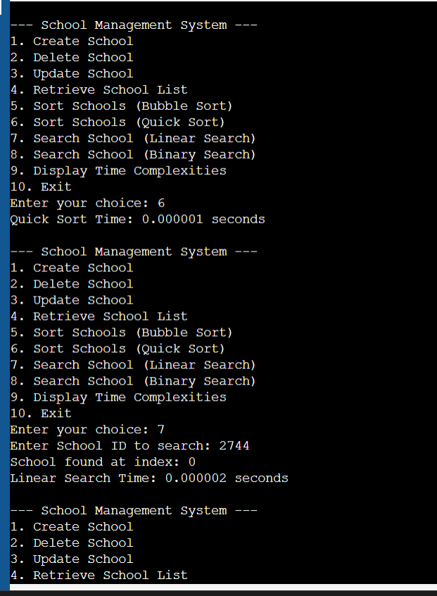
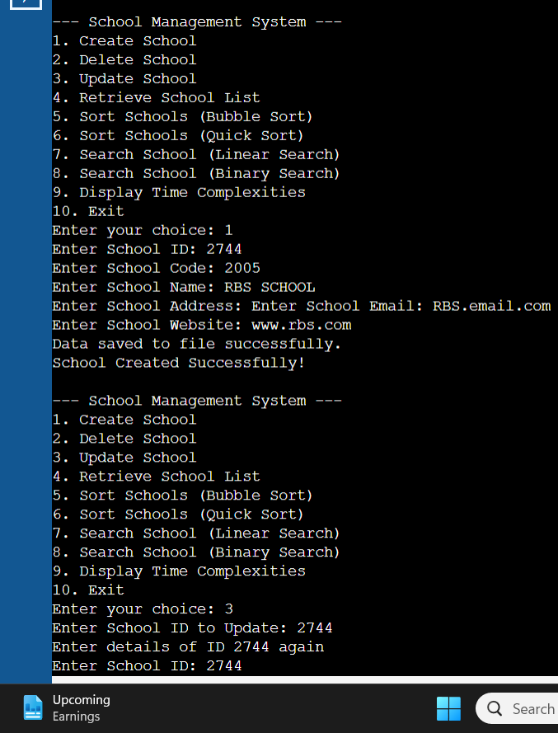
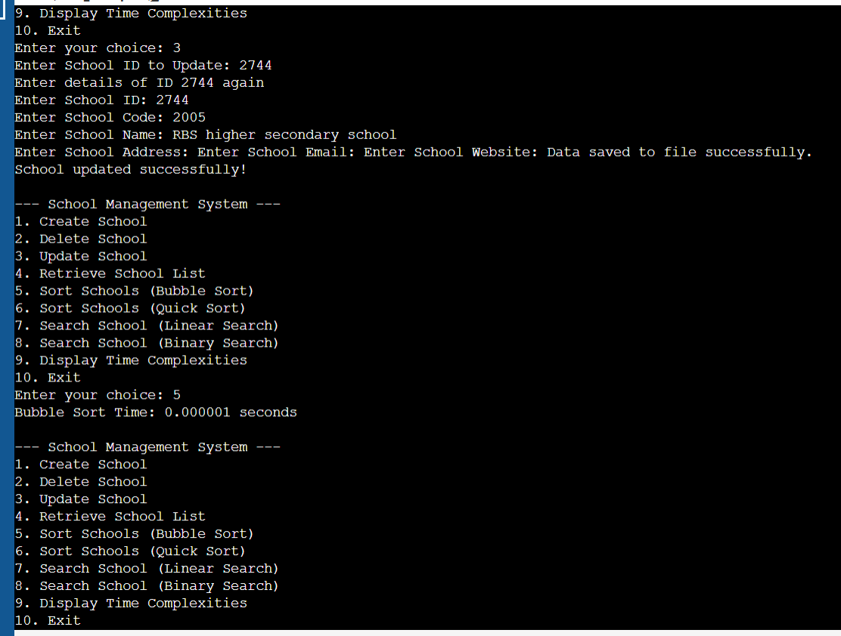
Sample Screen Shots[*Screen shot of CRUD,Sorting,Searching,Comparison(both sorting and Searching and Storage)]

Slide 17
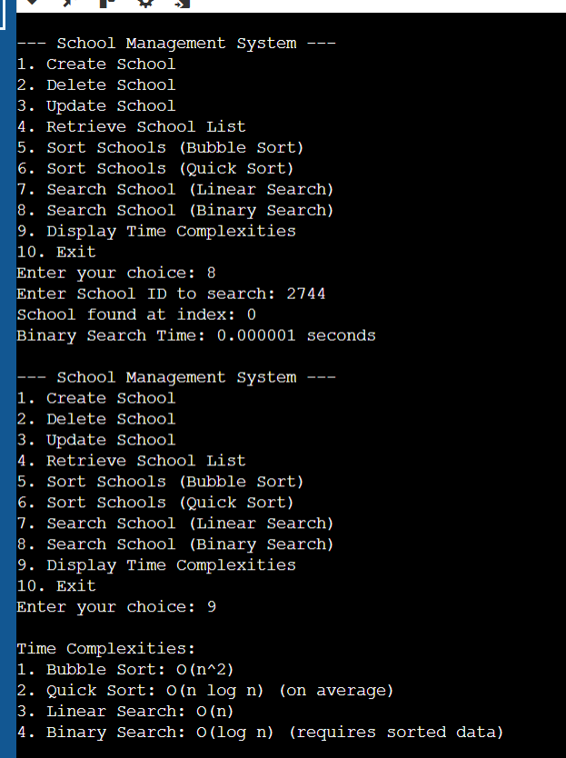
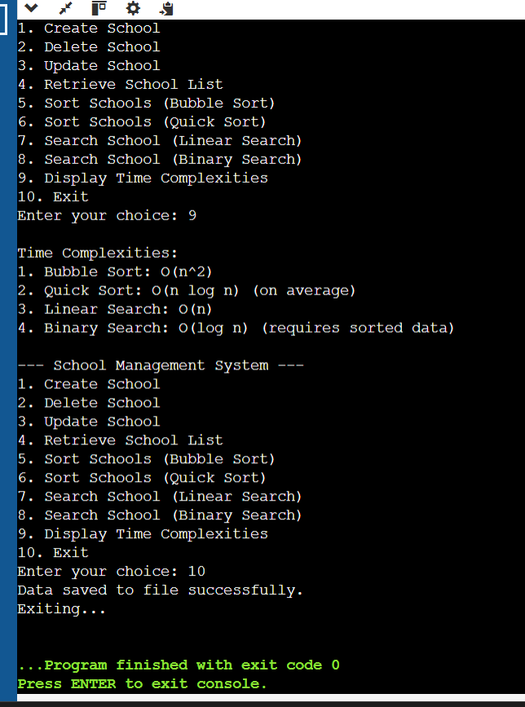
Sample Screen Shots[*Screen shot of CRUD,Sorting,Searching,Comparison(both sorting and Searching and Storage)]

Slide 18
Conclusion
The School Management System effectively demonstrates the use of basic algorithms and data manipulation strategies in the school's and educational institution's data organization and management. By integrating sorting algorithms like Bubble Sort and Quick Sort with searching algorithms like Linear and Binary Search, it proposes efficient and scalable solutions for data retrieval and management. Data persistence improves with the system's ability to save and load the data from a file, thus providing reliability and usability following program termination.

Slide 19
Thank You

